Slide 1
Modelling network topologies
Jurij Bešter, Andrej Orehek, Kamile Radlinskaite, Domen Rek

Slide 2
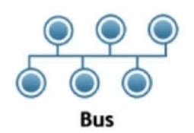

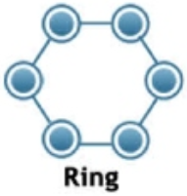
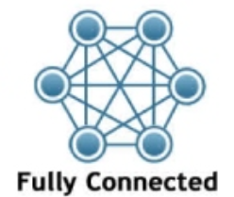
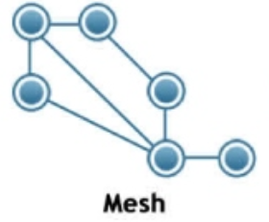
Definition
A network topology describes the arrangement of systems on a computer network. It defines how the computers, or nodes, within the network are arranged and connected to each other.

Slide 3
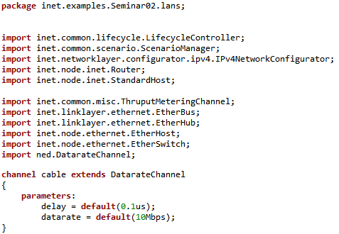
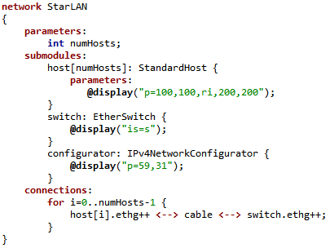
.NED

Slide 4
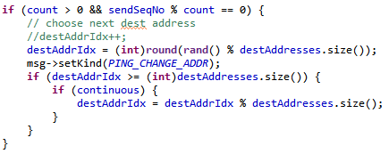
PingApp

Slide 5
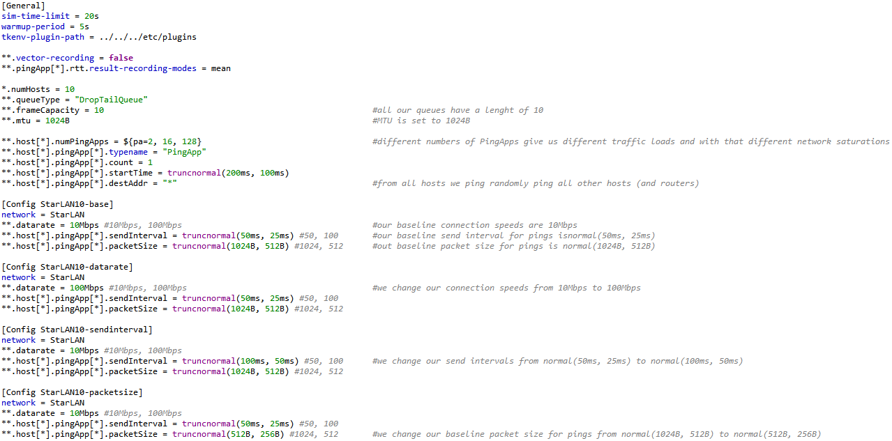
.ini

Slide 6
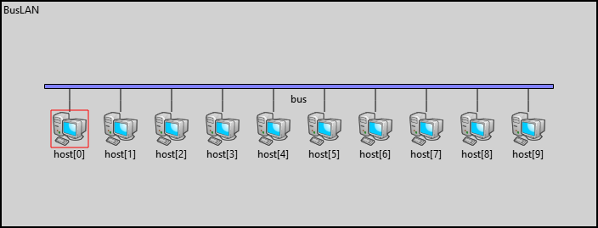
Bus network topology
The topology consist of single shared bus (transmission medium) to which all hosts are connected.

Slide 7
Advantages
Disadvantages
Easy to implement and extend
Relatively cheap as it does not require network devices (switches, routers ...) and usually requires less physical medium then most of others topologies
Works well for small networks and is resistant to host failures
Bus is single point of failure and can shut down whole network if damaged
Only one shared bus can became bottleneck in large networks or heavy traffic environments
Sensitive to package collisions and is hard to troubleshoot any problems (host misbehavior)
Potentially unsafe as all hosts can listen to traffic on medium

Slide 8
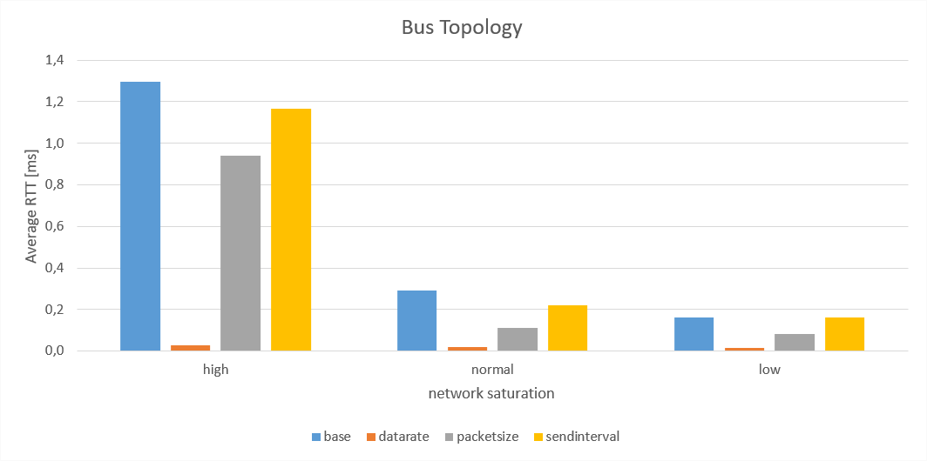
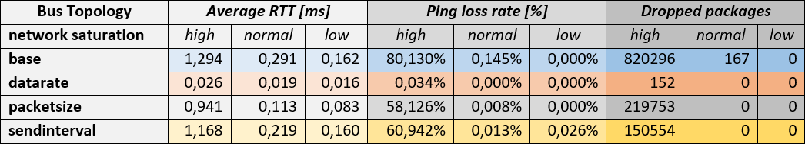

Slide 9
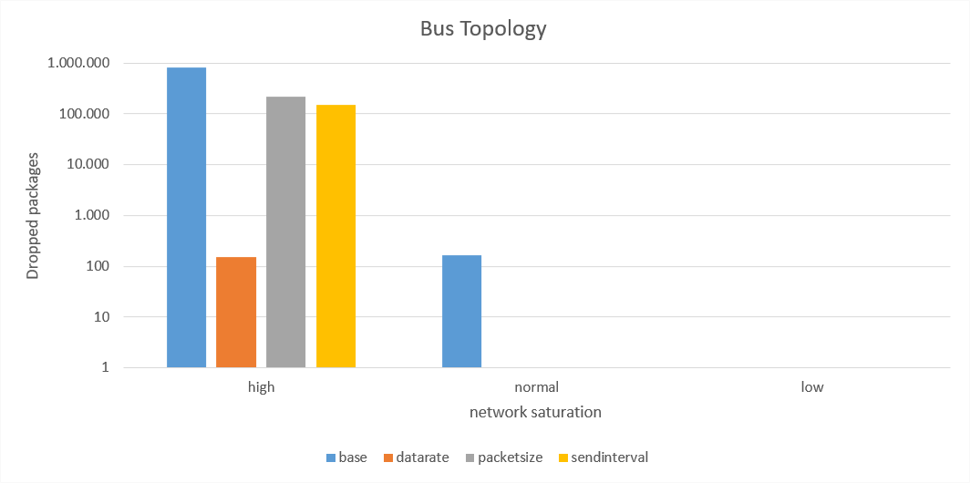
Results

Slide 10
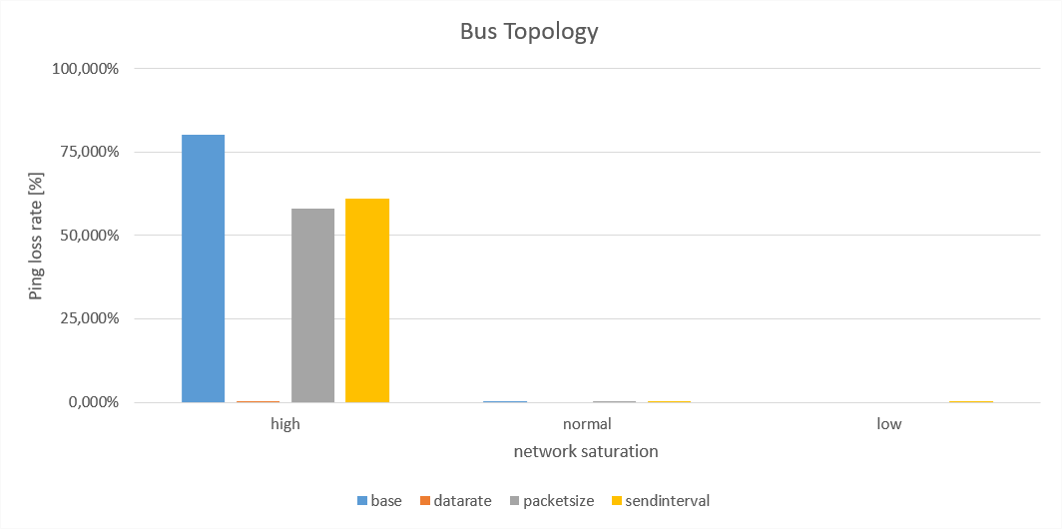

Slide 11
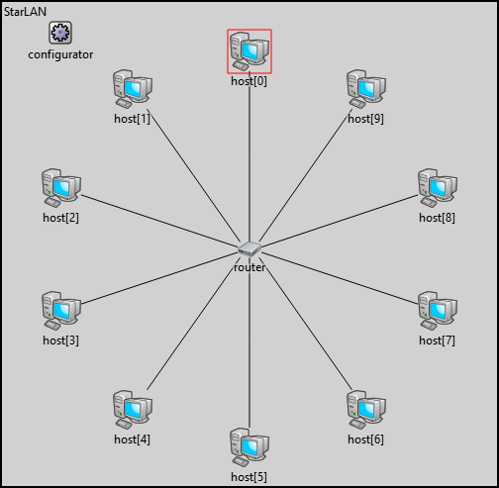
Star network topology
In star network topology all nodes are connect to central network device such as switch, router, network hub ...

Slide 12
Advantages
Disadvantages
If a connection between central device and node fail, the network continues to operate normally
Central device represents single point of failure and in case of failure it takes down whole network
Because each node is connected to central device it can be expensive to connect all nodes to central device

Slide 13
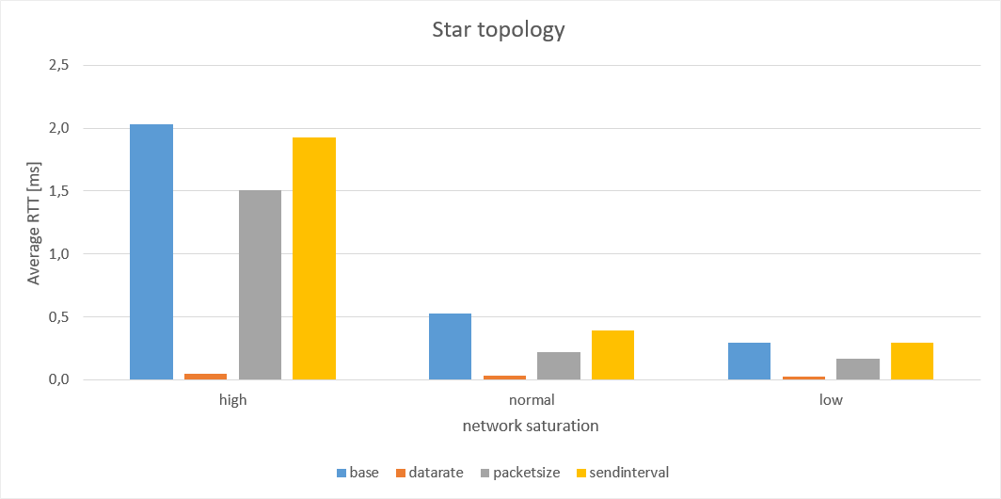
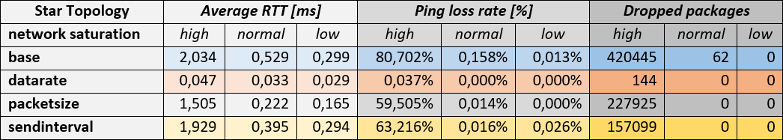

Slide 14
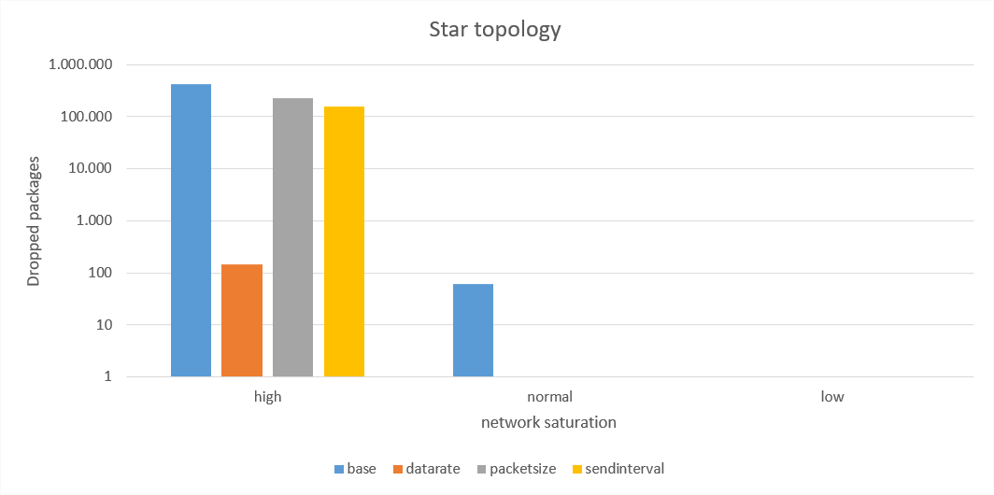
Results

Slide 15


Slide 16
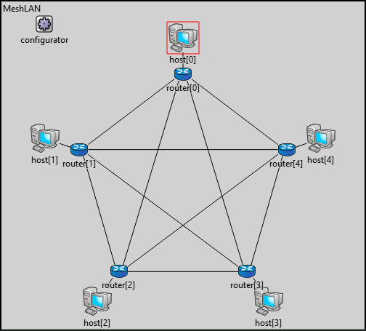
Fully connected Mesh network topology
Fully Connected Network Topology (Full mesh topology) is a network topology where all nodes are connected directly to each other.

Slide 17
Advantages
Disadvantages
Very high reliability and security
If one link in the mesh topology breaks, the network remains active
No single points of failure.
Uses too many connections and therefore requires a great deal of wiring, especially in networks with high number of nodes.
It is a quite expensive network topology and is extremely impractical for the large networks. This is why it is rarely used.

Slide 18
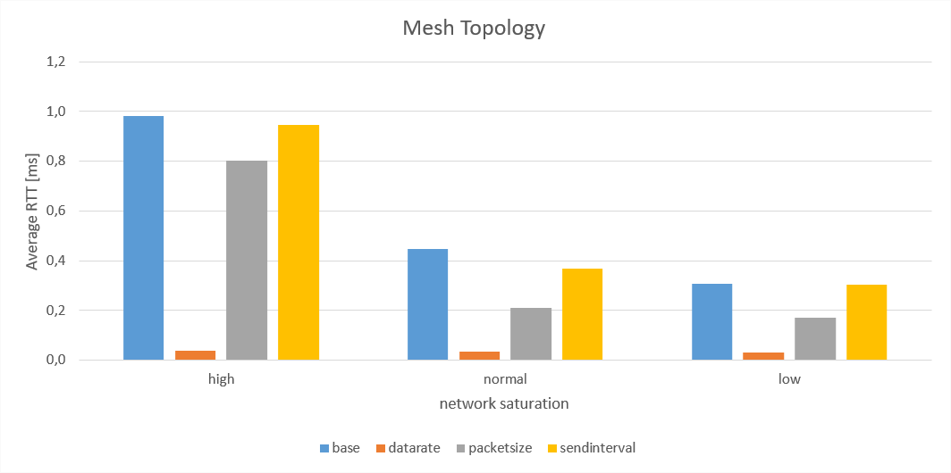
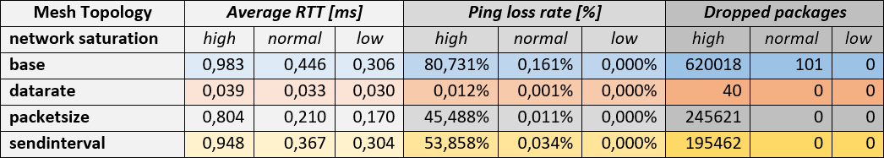

Slide 19
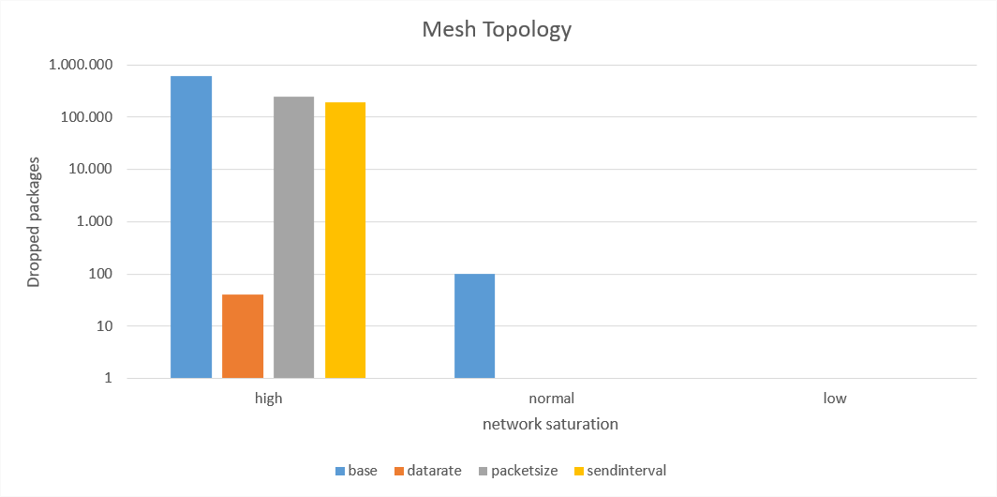
Results

Slide 20
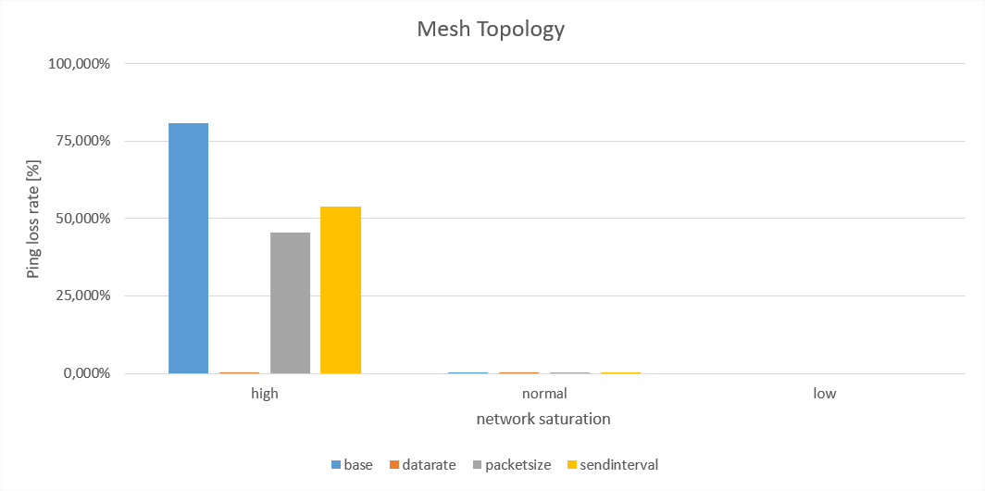

Slide 21
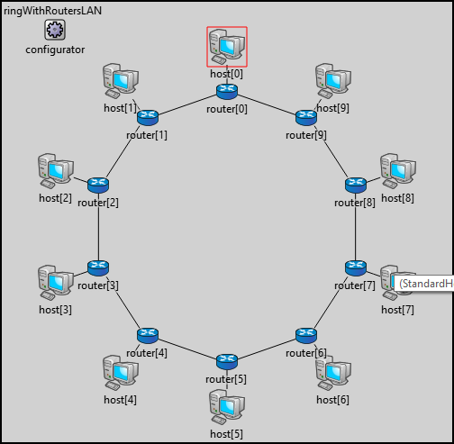
Ring network topology
A ring topology is a network configuration in which device connections create a circular data path. Each networked device is connected to two others.

Slide 22
Advantages
Disadvantages
All data flows in one direction, reducing the chance of packet collisions
A network server is not needed to control network connectivity between each workstation
Data can transfer between workstations at high speeds
Additional workstations can be added without impacting performance of the network
All data being transferred over the network must pass through each workstation on the network, which can make it slower than a star topology
The entire network will be impacted if one workstation shuts down
The hardware needed to connect each workstation to the network is more expensive than Ethernet cards and hubs/switches

Slide 23
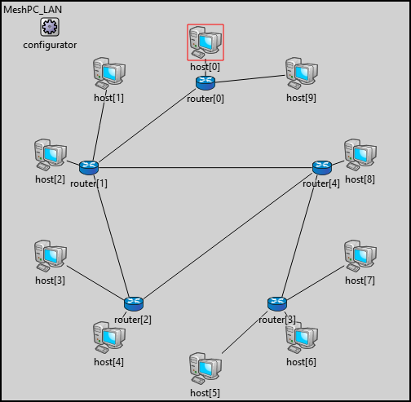
Partially connected Mesh network topology
At least two of the computers in the network have connections to multiple other computers in that network.

Slide 24
Advantages
Disadvantages
In the event that one of the primary computers or connections in the network fails, the rest of the network continues to operate normally
Usually in this type of topology more than one path can exist between nodes
It is an inexpensive way to implement redundancy in a network
Less expensive to implement and yields less redundancy than full mesh topology

